Slide 1
CGB1122 – DATA STRUCTURES END SEMESTER REVIEW
Academic Year: 2025 – 2026 (Even Semester)
Register Number : 927625BSC003,927625BSC058,927625BCS187
Section Roll Number : A502,A557,A562
Name : Anushka M , Swedhachellam K , Vindhiyaa P
Year : I
Semester : II
Section : A5
Date : 03-06-2026

Slide 2
Project Title
Cafeteria Management and Ordering System
Subject: Data Structures

Slide 3
ABSTRACT
The Cafeteria Management and Ordering System is developed using the C programming language by applying fundamental data structures such as arrays, queues, and stacks to create an efficient and user-friendly ordering system. Arrays are used to store and manage menu items, enabling quick access to food names, prices, and categories. The queue data structure handles customer orders in a first-in-first-out (FIFO) manner, ensuring fair processing based on the order of arrival. Additionally, a stack provides an undo feature, allowing users to remove the most recently added item during ordering. The system includes an automatic billing feature that calculates the total amount based on selected items and quantities, along with discount and tax calculations for generating the final bill. This project demonstrates how data structures can be effectively used to improve efficiency, reduce errors, and simplify cafeteria management operations.

Slide 4
ABSTRACT WITH CO & PO MAPPING
Abstract | CO | POs
The Cafeteria Management and Ordering System is developed using the C programming language with data structures like arrays, queues, and stacks to make the ordering process efficient and simple. Arrays are used to store and manage menu items such as food names and prices, allowing quick access. The queue is used to handle customer orders in a first-in-first-out (FIFO) manner, ensuring fair processing. A stack is implemented to provide an undo feature, enabling users to remove the last added item easily. The system also includes automatic bill calculation based on selected items, along with discount and tax computation. Overall, this project demonstrates the practical use of data structures in building an effective cafeteria management system | CO1 CO2 CO3 CO4 CO5 | PO1(2) PO2(2) PO3(3) PO5(3) PO8(3) PO9(2)

Slide 5
INTRODUCTION
The Cafeteria Management and Ordering System is a simple and efficient application developed using the C programming language to manage food ordering in a cafeteria. In many cafeterias, the ordering process is often done manually, which can lead to delays, errors, and confusion in handling multiple customer requests. This project aims to overcome such issues by automating the process using fundamental data structures. Arrays are used to store and display menu items, queues are used to manage customer orders in a systematic first-in-first-out manner, and stacks are used to provide an undo feature for correcting mistakes. The system also includes automatic bill calculation with discount and tax, ensuring accuracy and saving time. Overall, this project demonstrates how basic data structures can be applied to solve real-world problems and improve efficiency in cafeteria management.

Slide 6
DATA STRUCTURES USED
The Cafeteria Management and Ordering System is developed using the C programming language by applying fundamental data structures such as arrays, queues, and stacks to create an efficient and user-friendly ordering system. Arrays are used to store and manage menu items, enabling quick access to food names, prices, and categories. The queue data structure handles customer orders in a first-in-first-out (FIFO) manner, ensuring fair processing based on the order of arrival. Additionally, a stack provides an undo feature, allowing users to remove the most recently added item during ordering. The system includes an automatic billing feature that calculates the total amount based on selected items and quantities, along with discount and tax calculations for generating the final bill. This project demonstrates how data structures can be effectively used to improve efficiency, reduce errors, and simplify cafeteria management operations.

Slide 7
ADVANTAGES
Fast Menu Management (Arrays) : Arrays store menu items in an organized manner, allowing quick access and easy display of food details.
Fair Order Processing (Queue) : The queue follows the FIFO principle, ensuring customer orders are processed in the order they are received.
Error Correction (Stack) : The stack provides an undo feature, allowing users to remove the most recently added item and correct mistakes easily.
Efficient Billing System : Data structures help manage ordered items efficiently, making bill generation faster and more accurate.
Improved System Performance : Using arrays, queues, and stacks reduces processing time and simplifies cafeteria operations, improving overall efficiency.

Slide 8
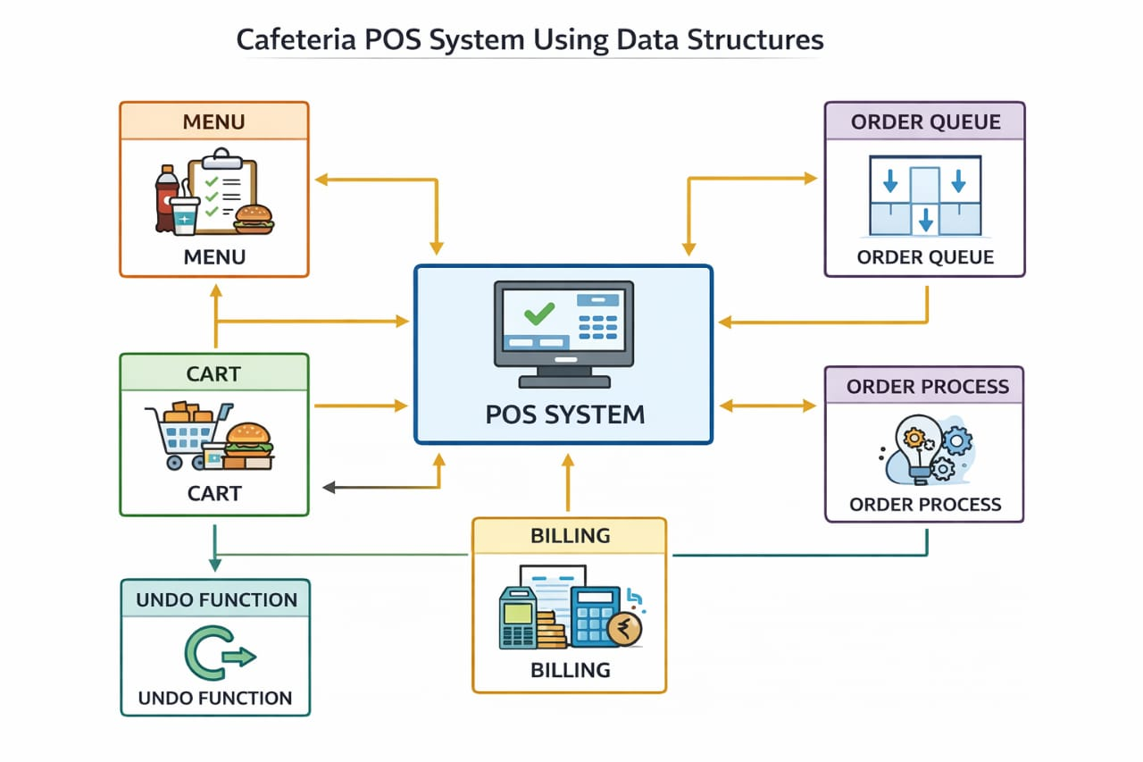
BLOCK DIAGRAM

Slide 9
BLOCK DIAGRAM - DESCRIPTION
The block diagram illustrates the working of the Cafeteria POS (Point of Sale) System using data structures. The system begins with the Menu Module, where food items and their details are stored and displayed. Customers select items and add them to the Cart Module for ordering. The Undo Function uses a stack data structure to remove the most recently added item if needed. Confirmed orders are placed in the Order Queue, which processes orders using the FIFO (First-In-First-Out) principle. The Order Process Module handles the preparation and management of orders. Finally, the Billing Module calculates the total amount, applies discounts and taxes, and generates the final bill for the customer.

Slide 10
LIST OF MODULES
Menu Module
Cart Module
Undo Module (Stack)
Order Module And Process Module(Queue)
Billing Module

Slide 11
MODULE DESCRIPTION
1. Menu Module - The Menu Module displays the list of food and beverage items available in the cafeteria. It shows item names, prices, and categories in an organized manner. Customers can browse the menu and select their preferred items. This module helps users easily view all available options. It provides the necessary information required for placing an order.
2. Cart Module - The Cart Module allows customers to add selected food items before confirming an order. It stores the chosen items along with their quantities and prices. Customers. It helps users verify their order before final submission. can review, modify, or remove items from the cart. The module continuously updates the total amount
3. Undo Module (Stack) - The Undo Module uses the Stack data structure to reverse the most recent action performed by the user. It allows customers to undo recently added items from the cart. Each action is stored in the stack and removed in Last-In

Slide 12
MODULE DESCRIPTION
-First-Out (LIFO) order. This module improves user convenience by correcting mistakes quickly. It ensures a flexible and user-friendly ordering experience.
4. Order Module and Process Module (Queue) - The Order Module records customer orders after confirmation. The Process Module uses a Queue data structure to manage and process orders in First-In-First-Out (FIFO) order. Orders are served in the same sequence in which they are received. This ensures fairness and efficient order handling. The module helps cafeteria staff manage multiple orders systematically and reduces processing delays.
5. Billing Module - The Billing Module generates the final bill for customer orders. It calculates the total amount based on selected items and quantities. The module displays a detailed summary of purchased items and their costs. It ensures accurate billing and payment processing. This module provides customers with a clear and organized invoice before order completion.

Slide 13
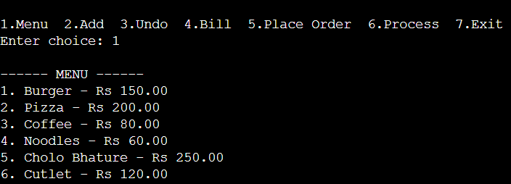
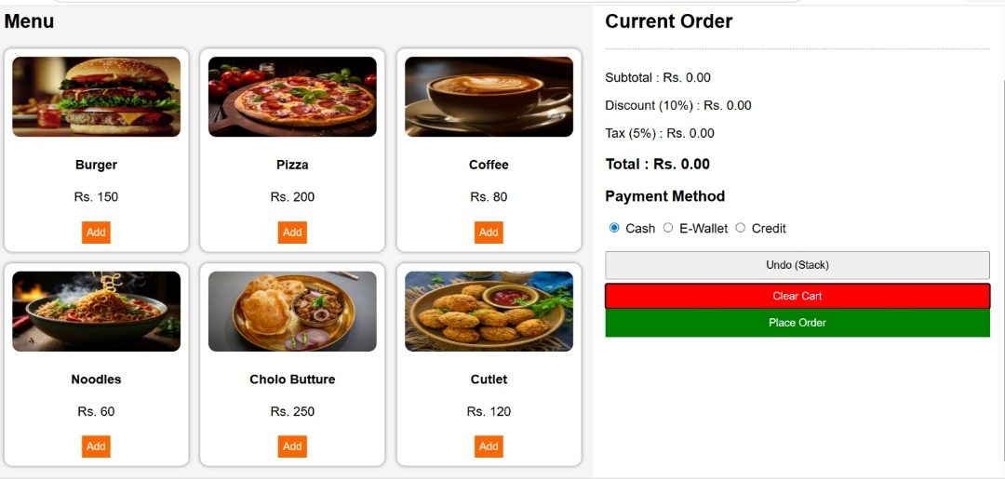
RESULTS AND DISCUSSION
Menu Module
The Menu Module displays all available food items along with their item IDs and prices, helping customers easily view and select their preferred meals.
Menu information is stored using arrays, which provide quick access to food details and simplify menu management operations.

Slide 14
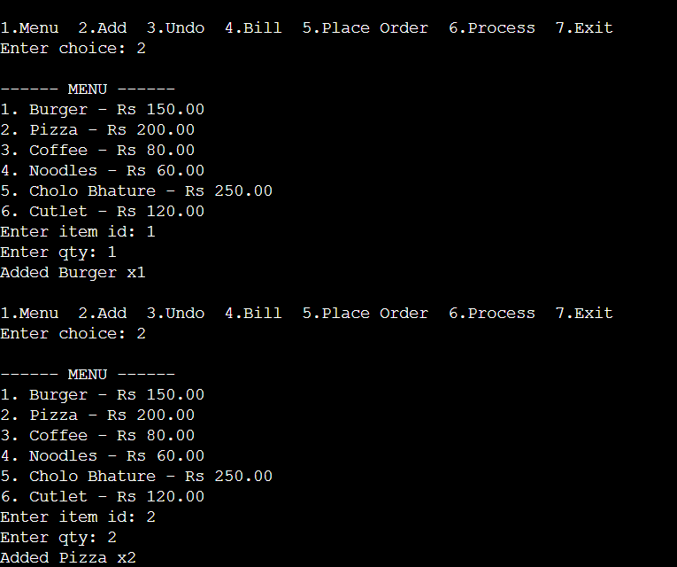
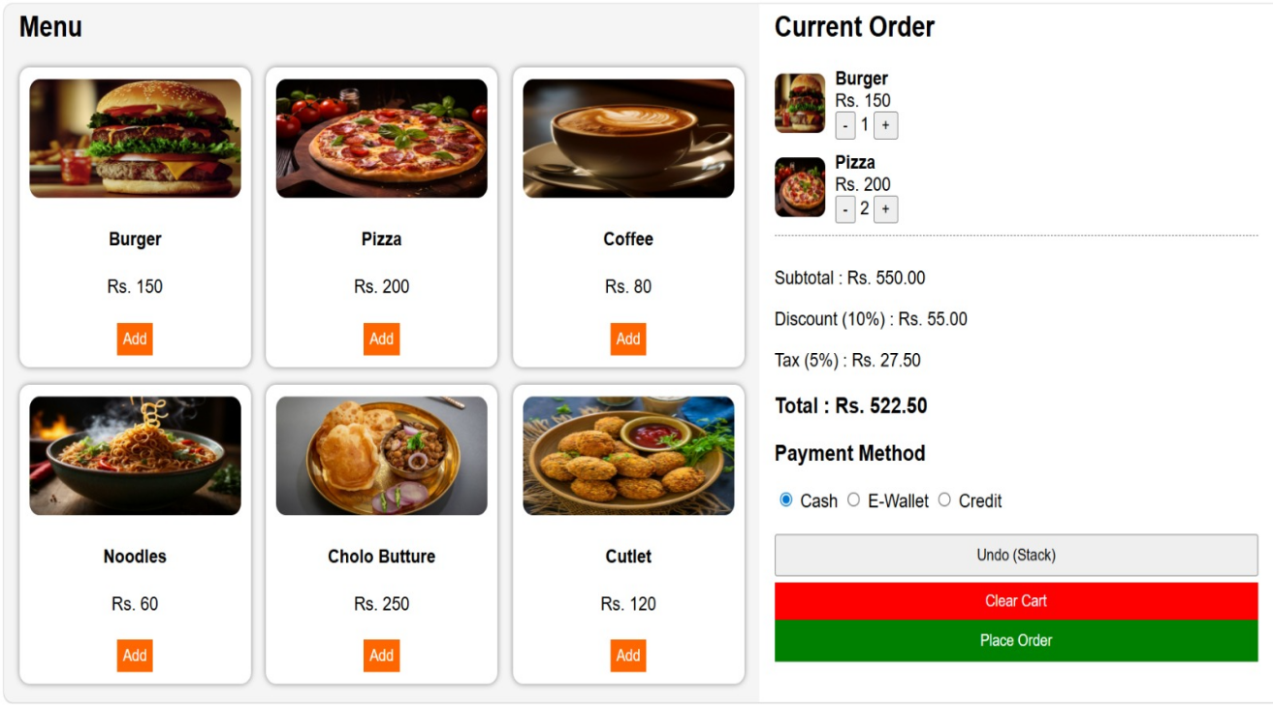
RESULTS AND DISCUSSION(CONT…)
Add Items to Cart
The Add Items to Cart module allows customers to choose food items and specify quantities before proceeding with the ordering process.
All selected items are stored temporarily in the cart, enabling users to review and modify their choices whenever required.

Slide 15

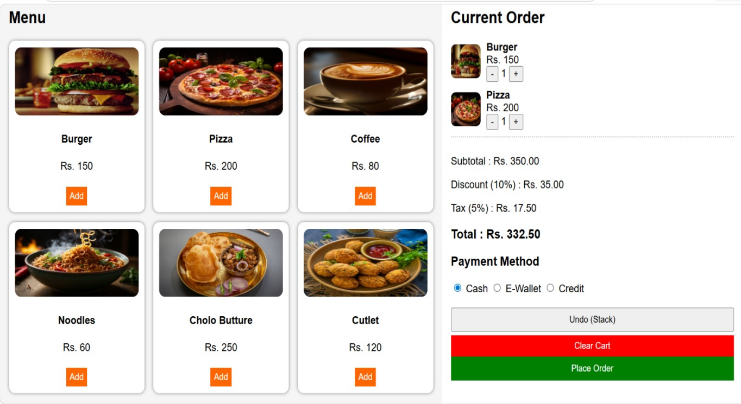
RESULTS AND DISCUSSION(CONT…)
Undo Operation
The Undo Operation uses the stack data structure to remove the most recently added item from the cart quickly and efficiently.
This feature helps customers correct ordering mistakes without affecting other items that have already been selected.

Slide 16
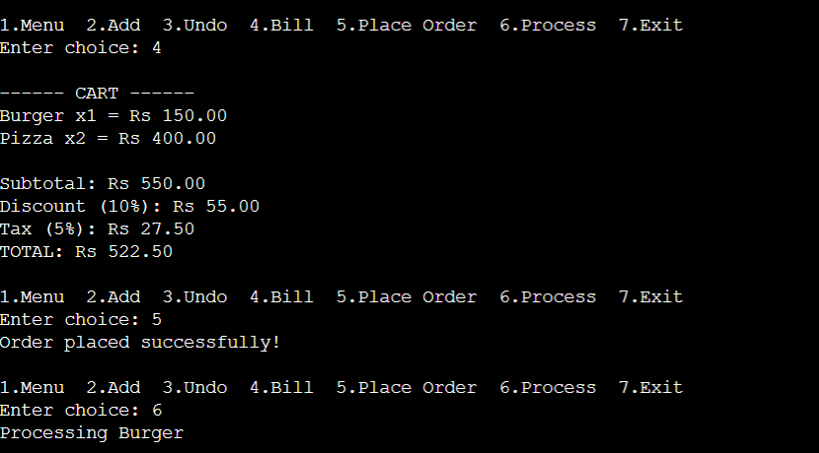
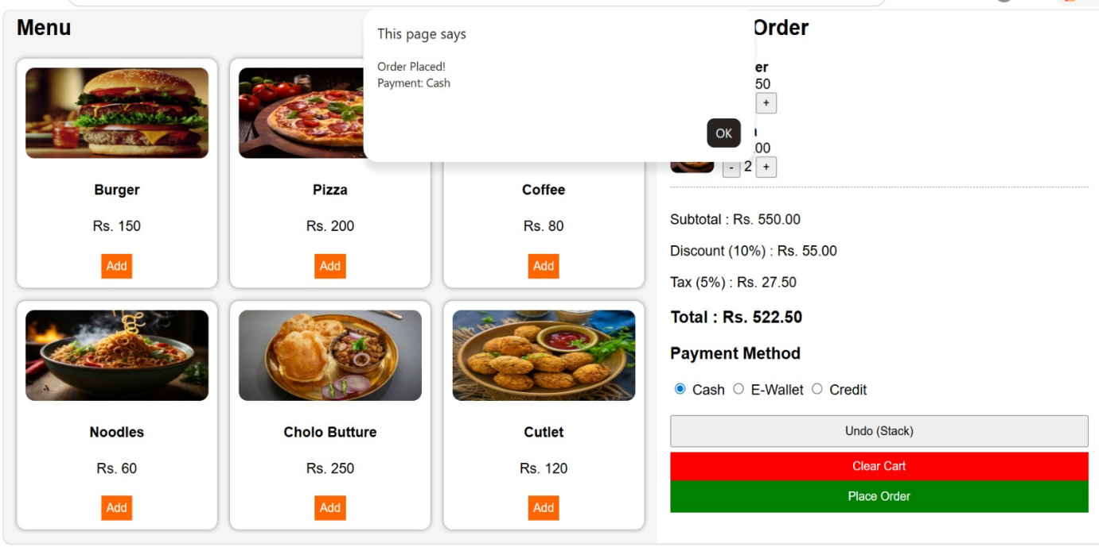
RESULTS AND DISCUSSION(CONT…)
Billing And Processing Order
The Billing and Order Management Module calculates the total bill amount, including discounts and taxes, and generates an accurate bill for the customer.
After billing, the customer's order is placed into the queue and processed using the FIFO principle, ensuring systematic and fair order handling.

Slide 17
CONCLUSION
The Cafeteria Management and Ordering System demonstrates how data structures and programming concepts can automate cafeteria operations efficiently. The system simplifies menu management, food ordering, order processing, and billing through a digital solution. Arrays, queues, and stacks are used to manage menu items, customer orders, and undo operations effectively. The automated billing system reduces manual errors and saves time. Overall, the project provides a simple, efficient, and user-friendly solution for cafeteria management.
Future Improvements:
A customer feedback system can be added to improve service quality.
A mobile application can be developed for easier access and ordering.
Order status notifications can be added for better customer updates.

Slide 18
REFERENCES
[1] “Python Crash Course” Eric Matthes, 2nd Edition, 2019, No Starch Press
[2] “Data Structures and Algorithms Made Easy” Narasimha Karumanchi, 2016 Edition, CareerMonk Publications
[3] “Head First Python” Paul Barry, 2nd Edition, 2016, O’Reilly Media
[4] “Learning Python” Mark Lutz, 5th Edition, 2013, O’Reilly Media
[5] “Database System Concepts” Abraham Silberschatz, Henry F. Korth, S. Sudarshan, 6th Edition, 2010, McGraw-Hill
[6] GeeksforGeeks - https://www.geeksforgeeks.org/python-programming-language
[7] W3Schools - https://www.w3schools.com/python
[8] TutorialsPoint - https://www.tutorialspoint.com/python/index.htm⁠
[9] Programiz - https://www.programiz.com/python-programming⁠
[10] Real Python - https://realpython.com

Slide 19
Thank You!!

